Slide 2
background, what is PB560, how PB 560 works, breakdown of PB 560, BOM analysis, potential AI function (Visible/invisible), new tech may need (3D printing for medical devices)
1. Ventilator description and mechanism (Wenjin)
2. PB560 key devices/components, auxiliary devices/components (Wenjin)
3. PB560 usage: use scenarios, user interface, frequency to change filter, … (Qibo)
4. Pros and cons compared to other products, how we can improve it (Dawn)
5. Regulation related issues, e.g. FDA certification, brand name, etc. (Dawn)

Slide 3
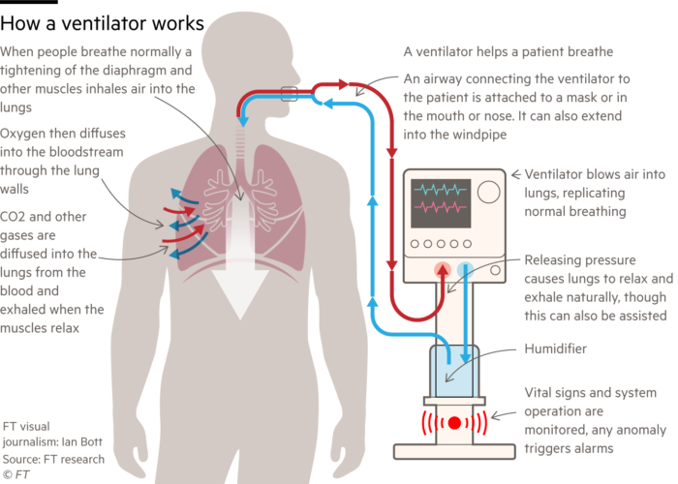
How a Ventilator Works

Slide 4


Slide 5
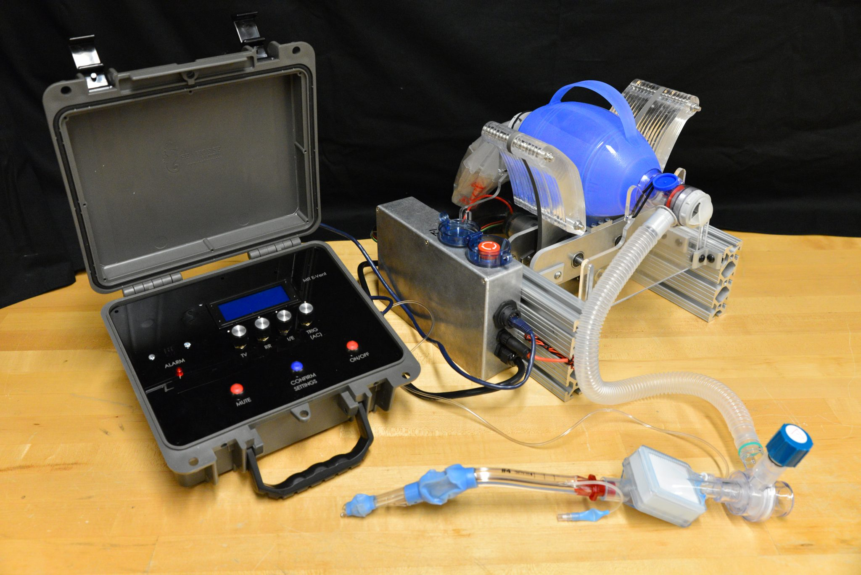

Slide 6
How Simple It Could Be

Slide 7

iAI’s Open-Source Ventilator

Slide 8
Why?
Contribute to the society
Show our capability
Build up the platform for future AI functions
Open-source hardware/software is the trend
Potential business

Slide 9
Objectives
Low-cost
Standard parts should be accessible without quoting
Customized parts should be printable by a 3D printer
Easy to assemble
A 2020 design

Slide 10
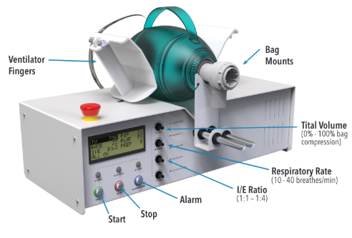
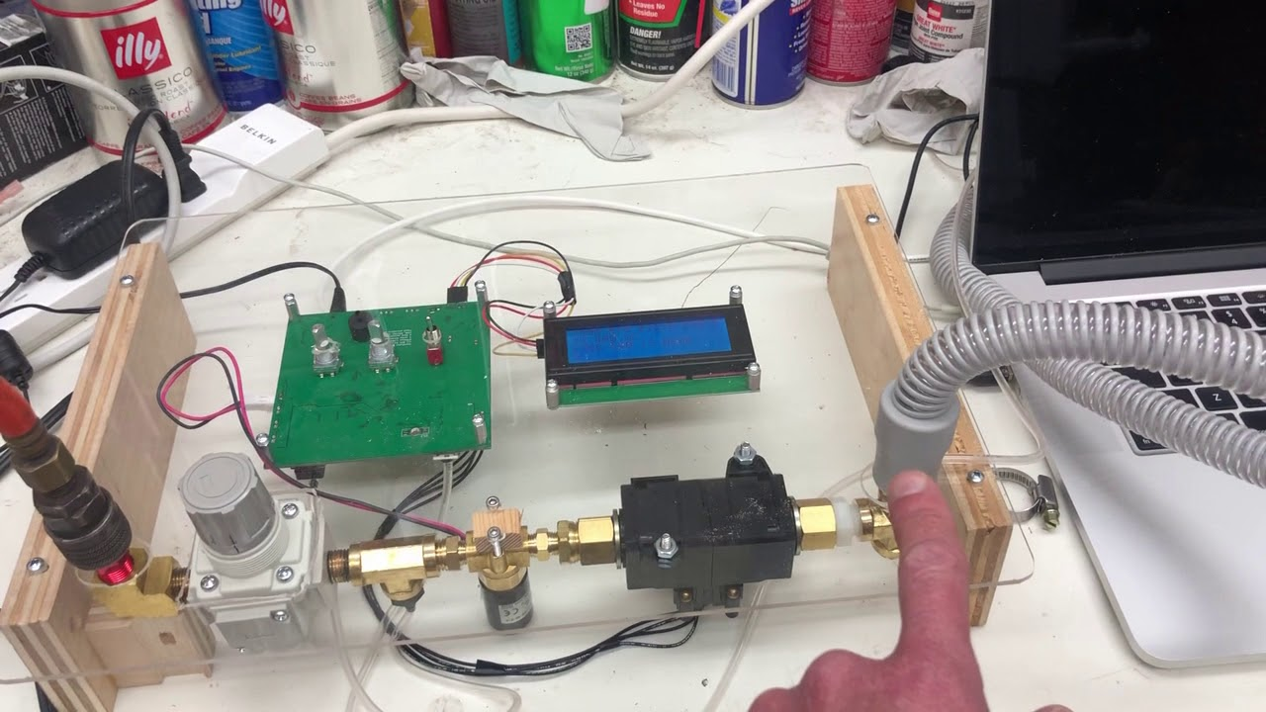
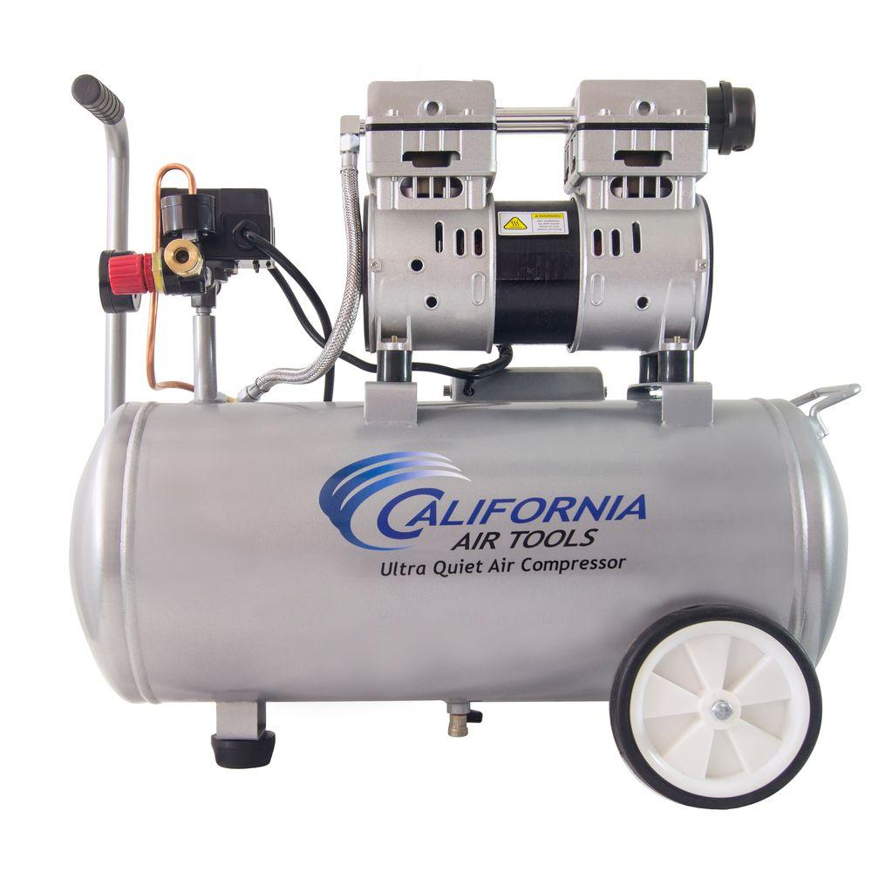
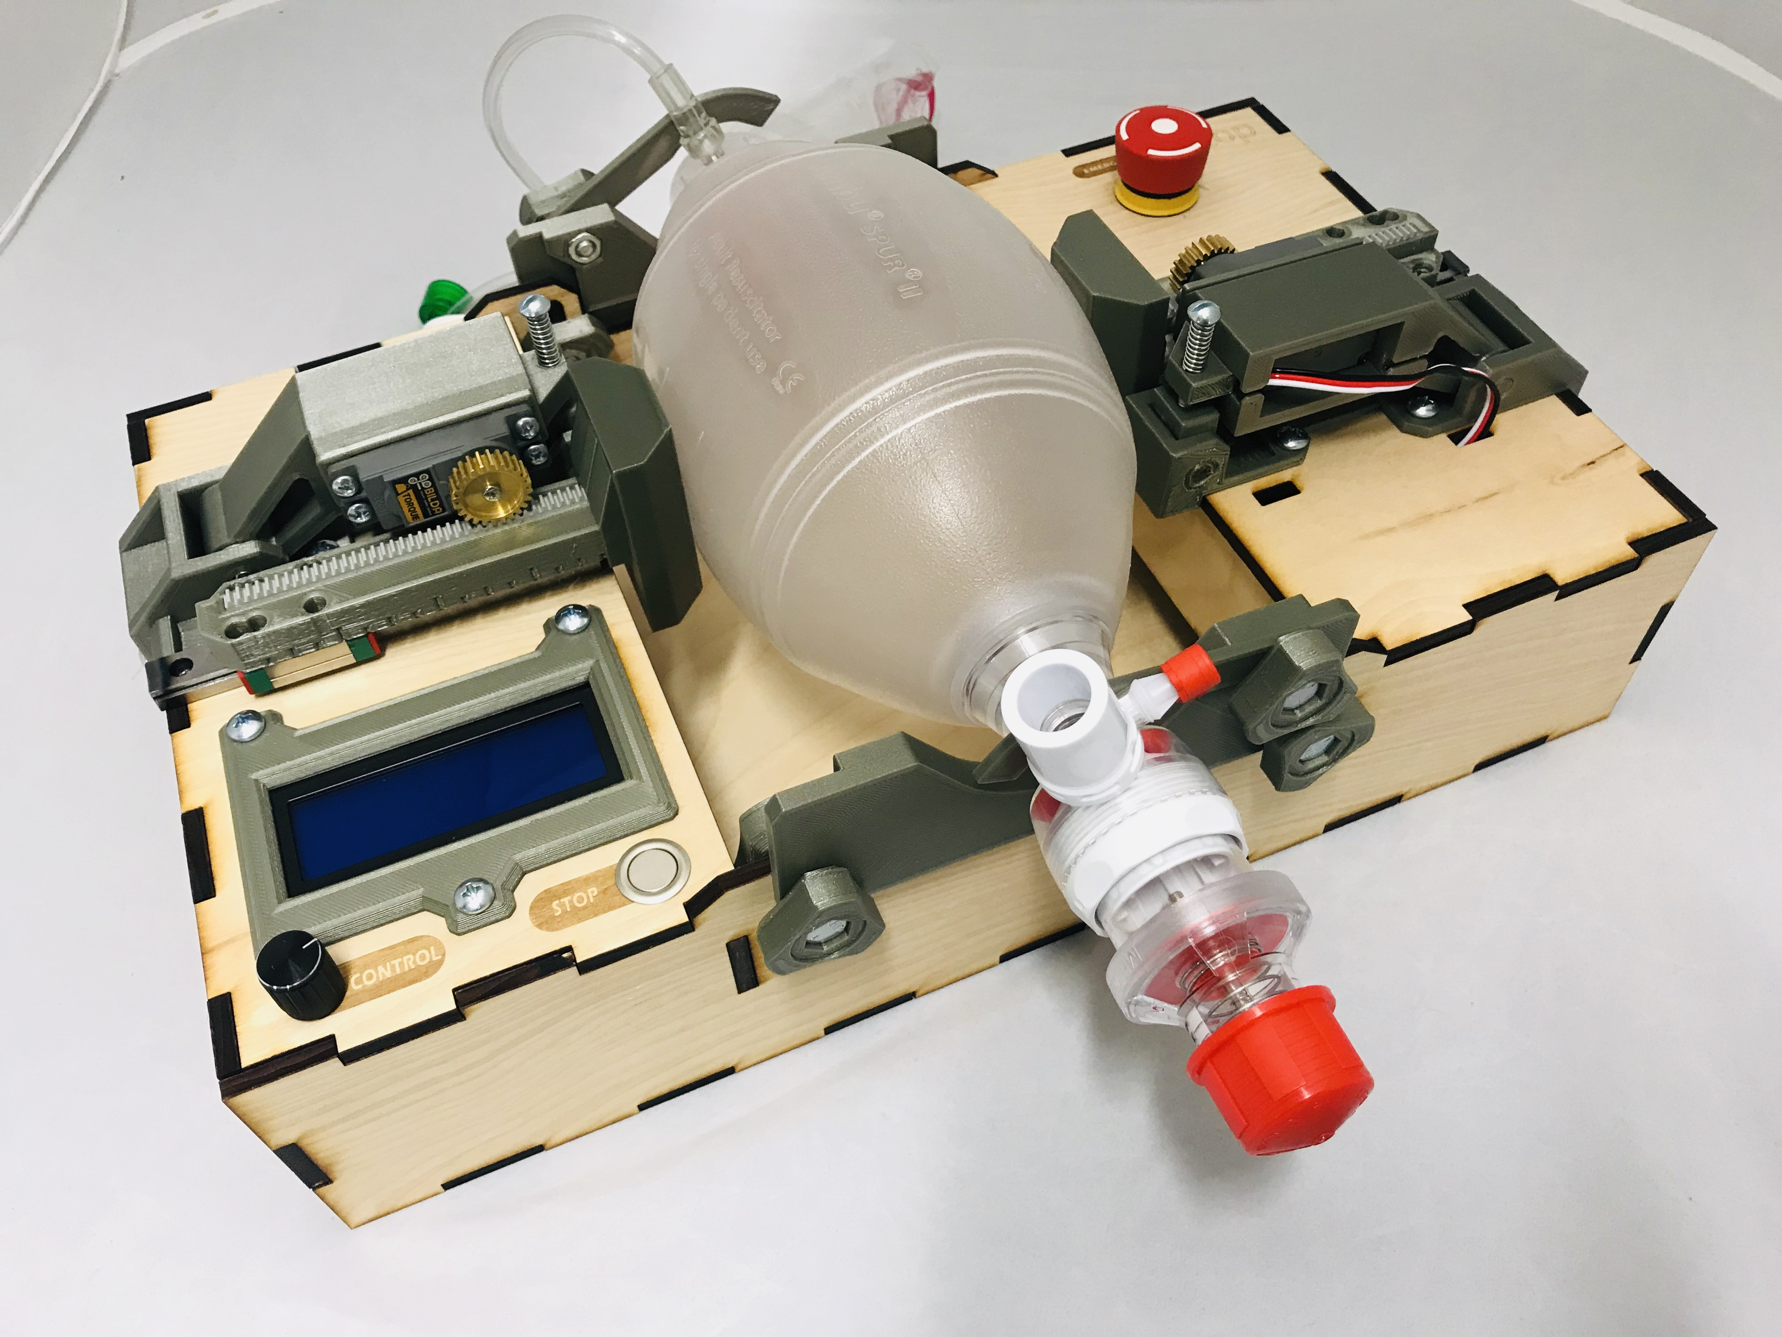
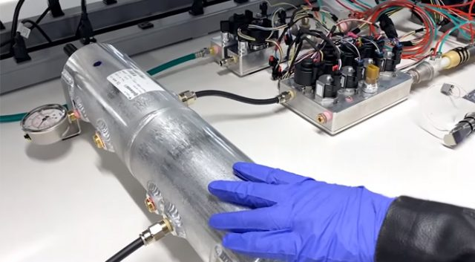
Current Open-Source Solutions
“Press the Bag” Solutions
“Tune the Flow” Solutions
https://e-vent.mit.edu/
https://op-vent.stanford.edu/
http://oedk.rice.edu/apollobvm/
Tesla Ventilator
100+ open-source ventilators
https://github.com/PubInv/covid19-vent-list

Slide 11

NeoBreath Open-Source Ventilator
Pneumatic System
Filter
Ducted Fan Blower
Bacteria Filter
Air/O₂ Chamber
Humidifier
Air
O₂
Temperature/Humidity Sensor
ESC
Flow Rate
Raspberry Pi
Pressure
Pressure
HMI
Power
PSU

Slide 12
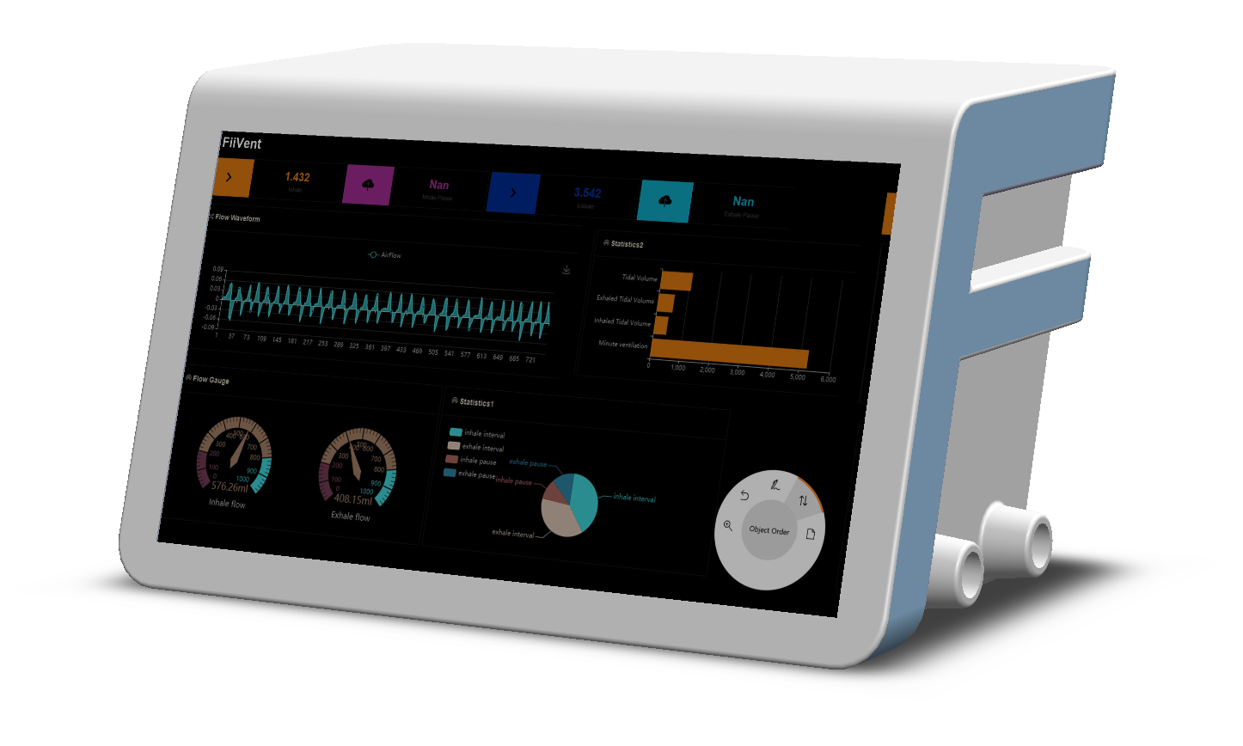
NeoBreath Open-Source Ventilator
Designed by iAI Labs

Slide 13
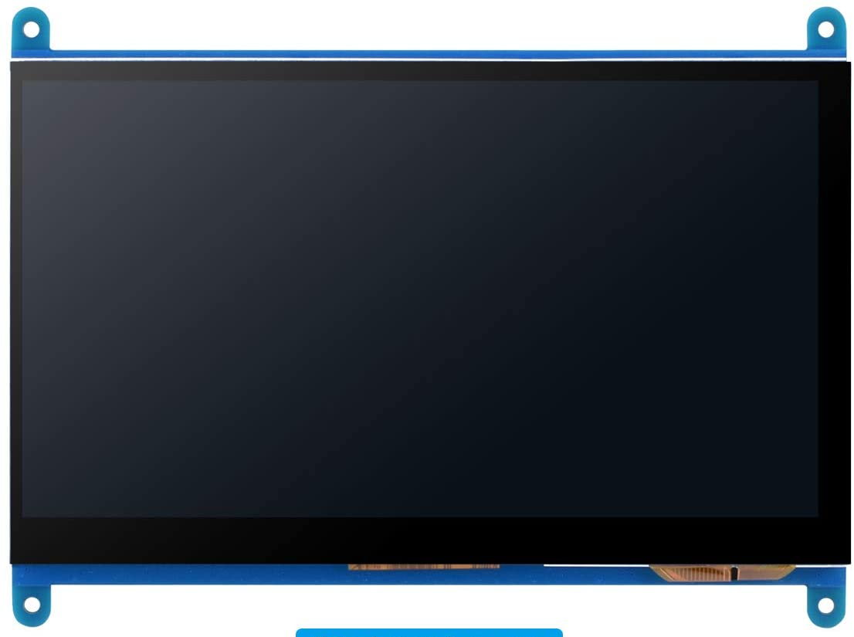
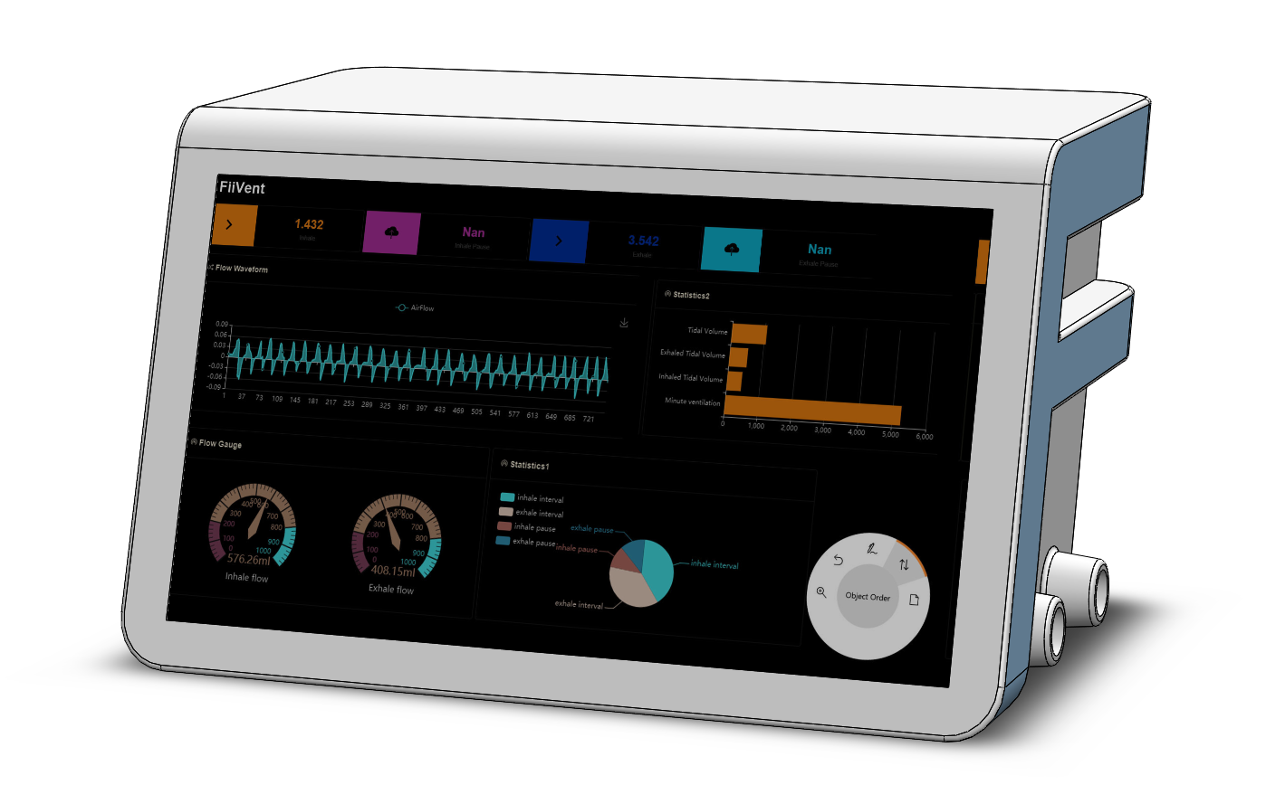
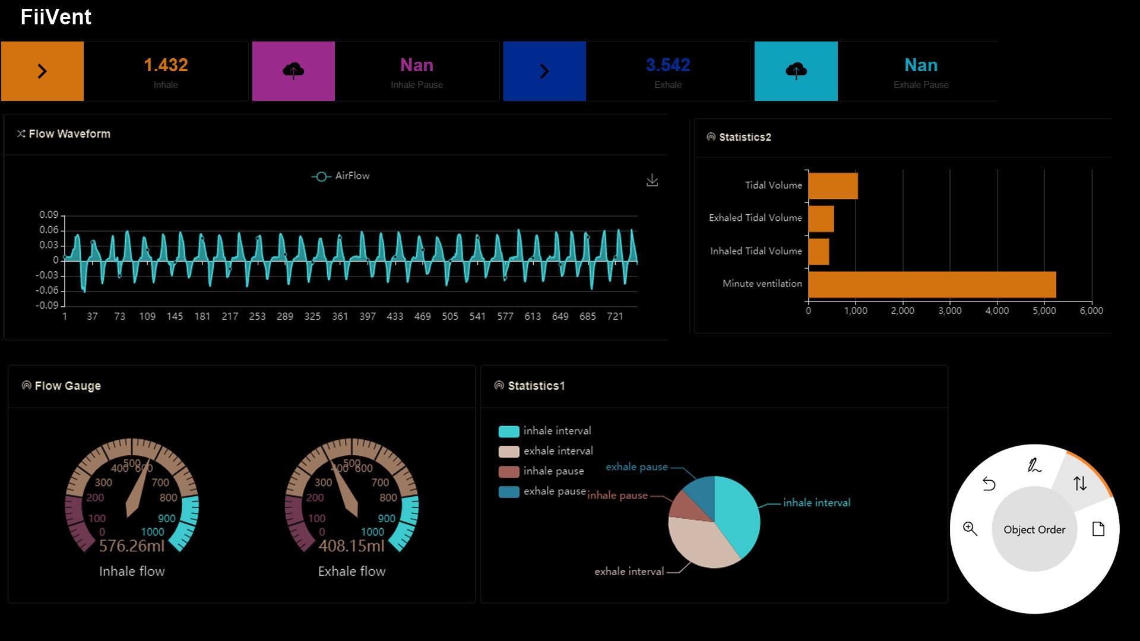
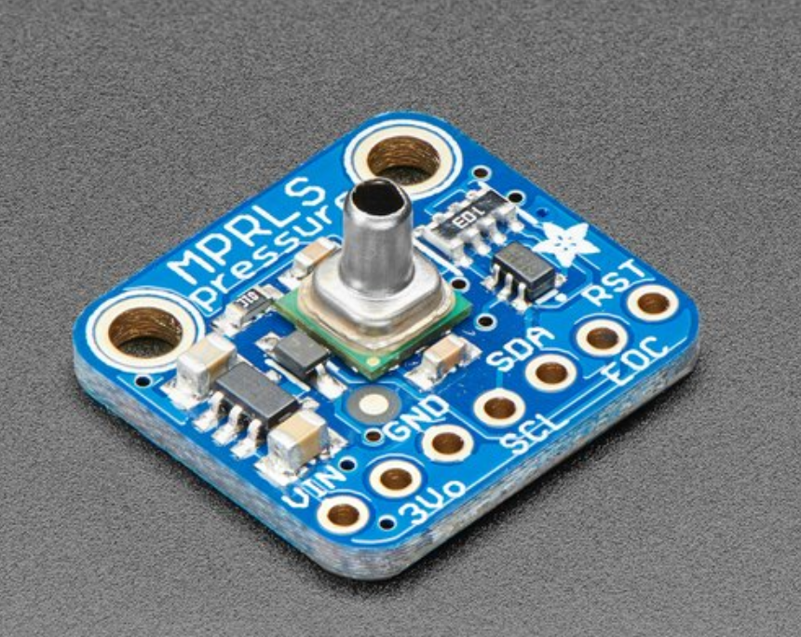
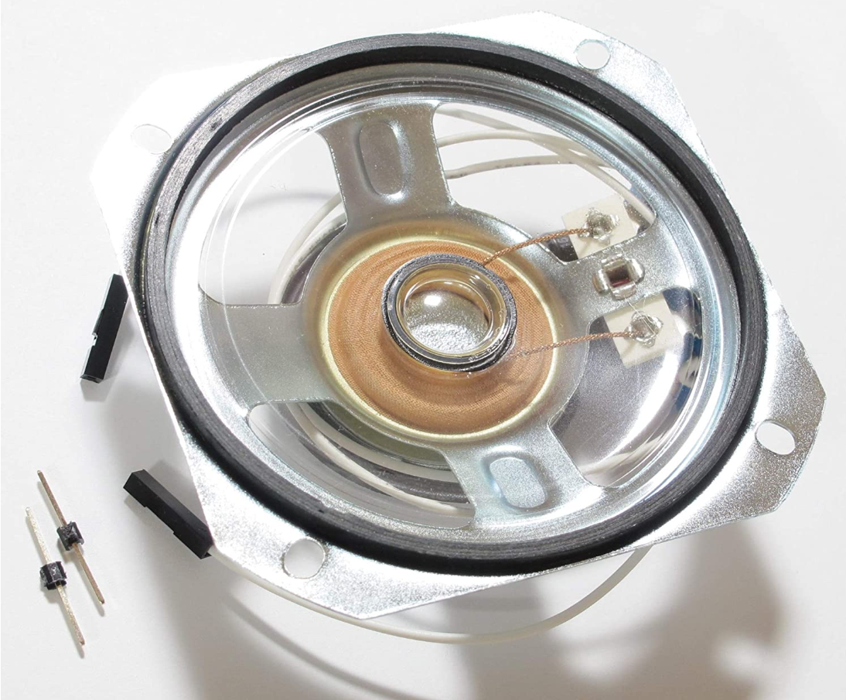
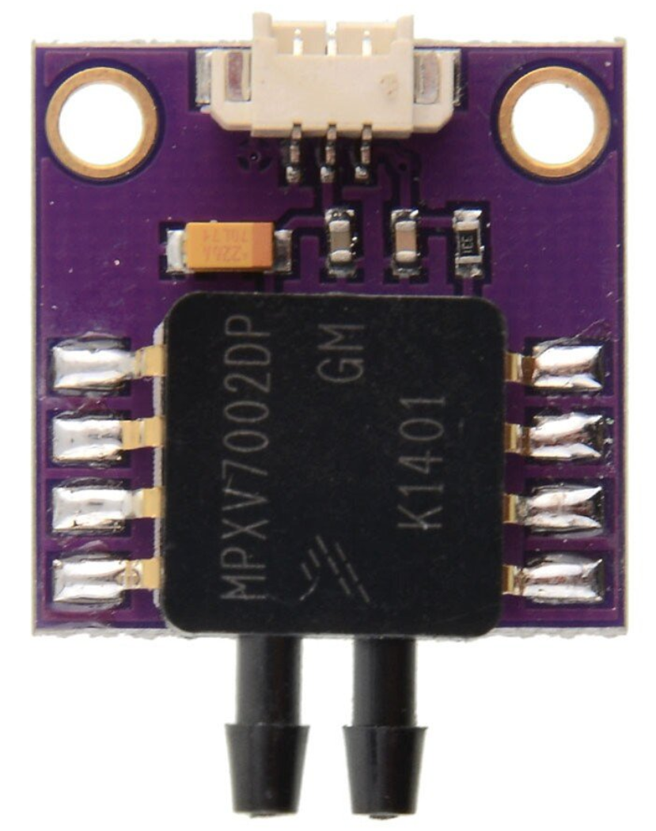
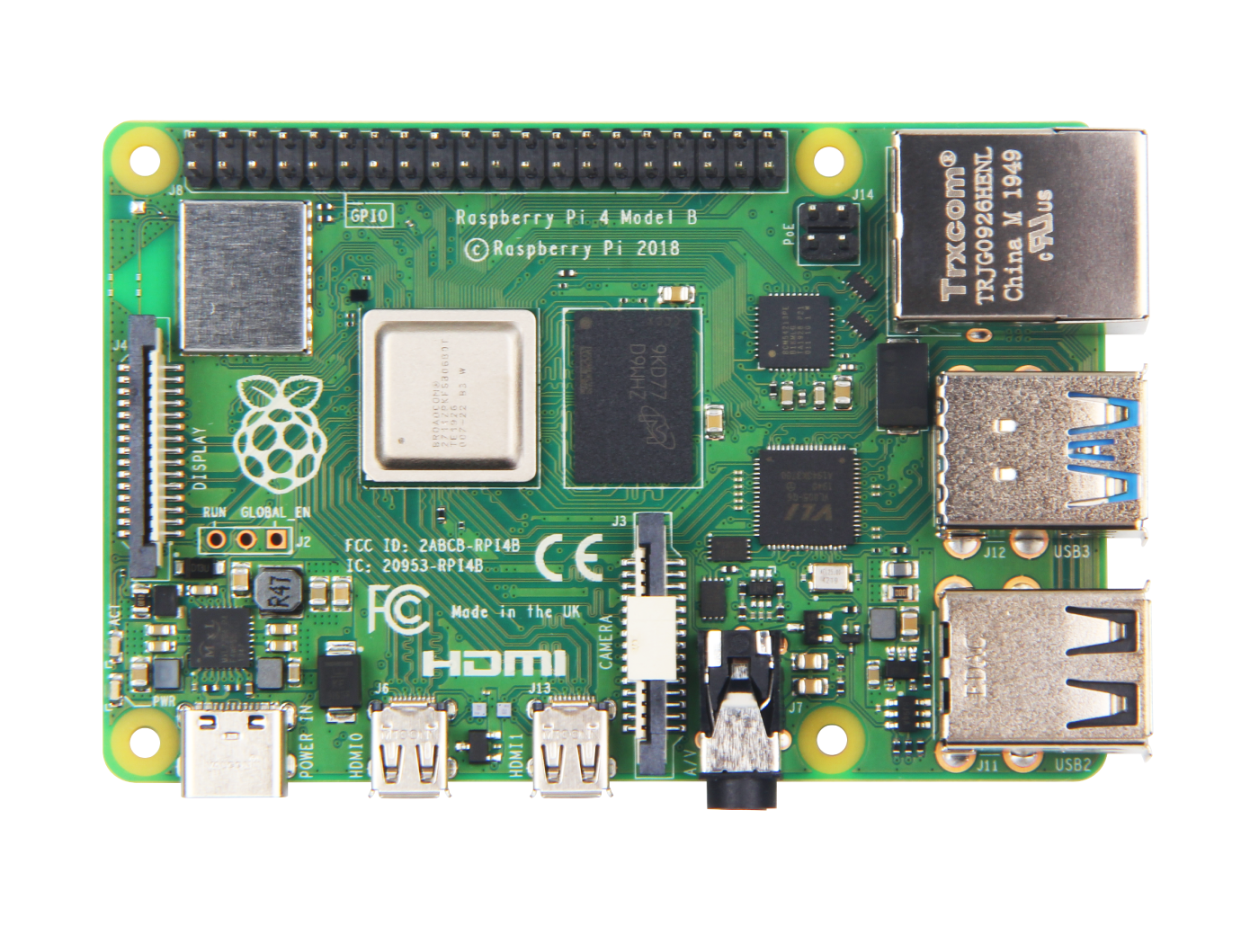
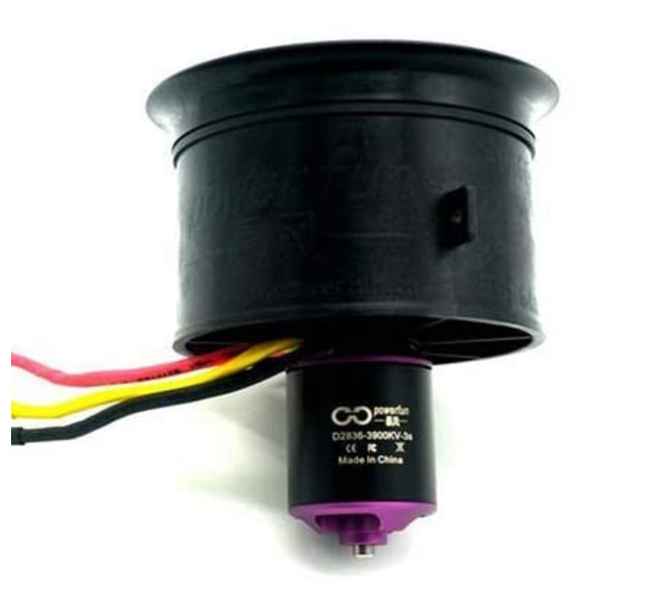
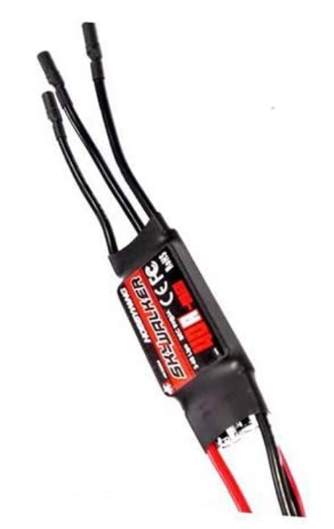
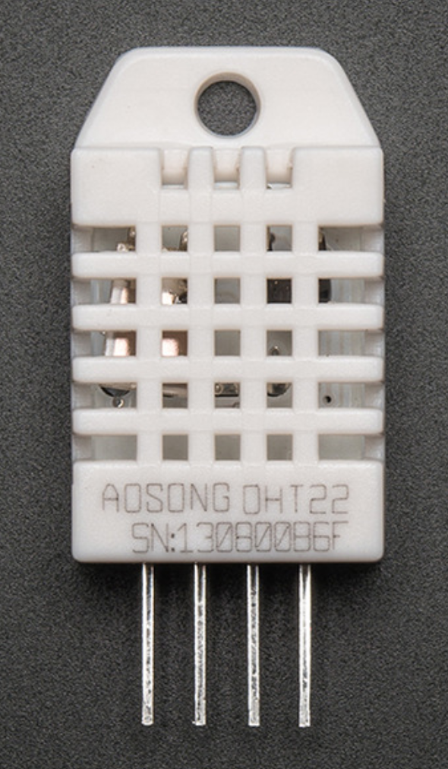
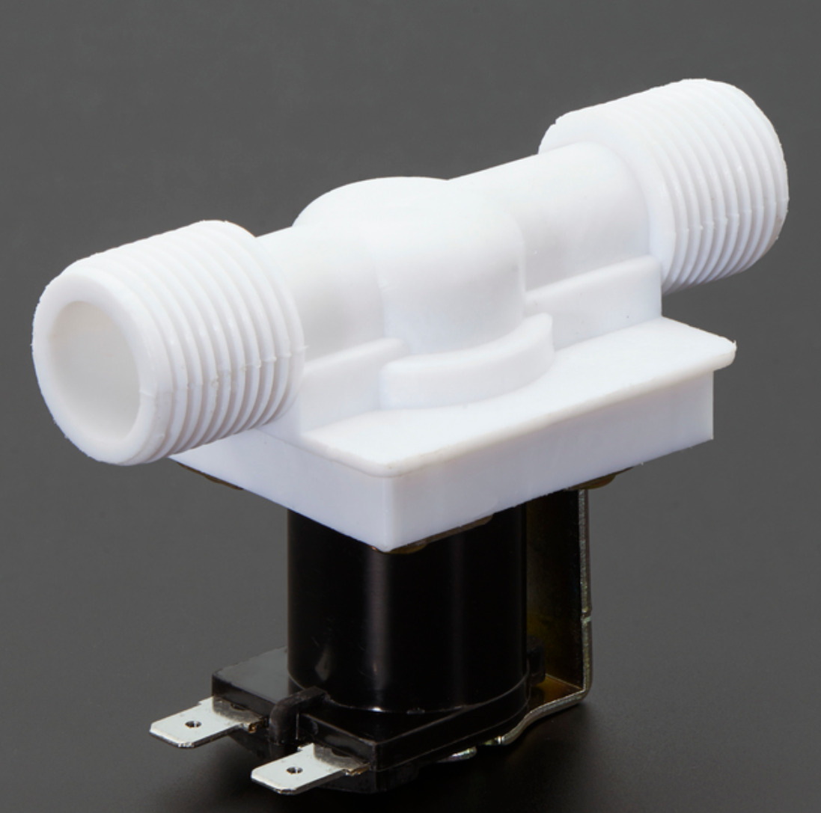
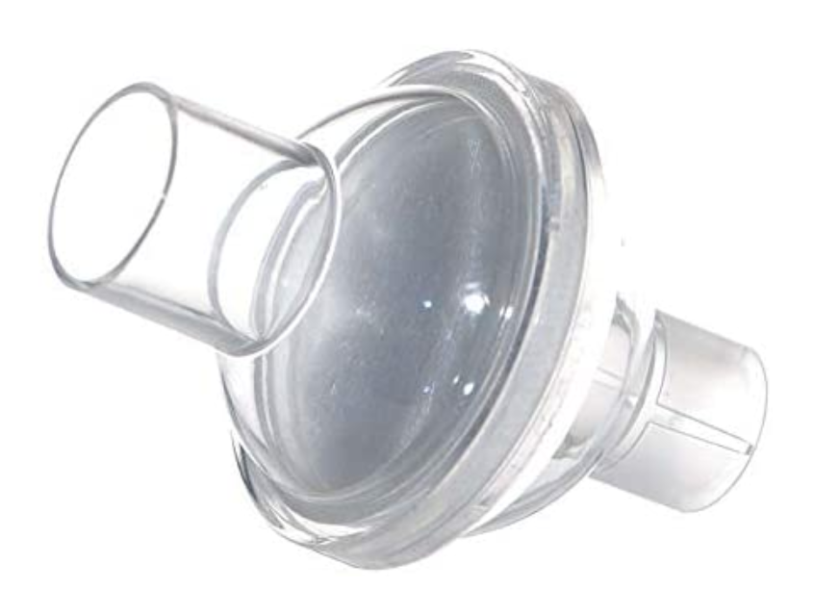
Pressure Sensor
Ducted Fan
Speaker
Touch Screen
Differential Pressure Sensor
Raspberry Pi
Temperature/Humidity Sensor
Bacteria Filter
Ducted Fan
ESC
Solenoid Valve

Slide 14
Touch Screen
Differential Pressure Sensor
Ducted Fan
Raspberry Pi
Temperature/Humidity Sensor
Pressure Sensor
Solenoid Valve
Bacteria Filter
Speaker

Slide 15
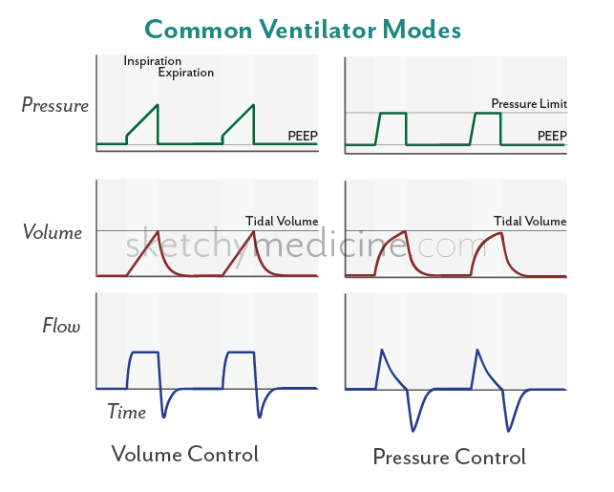
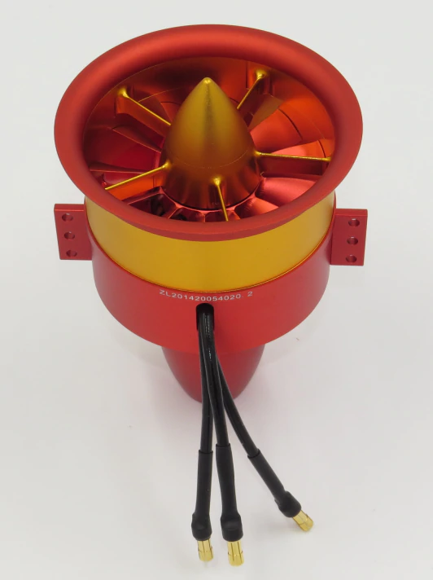
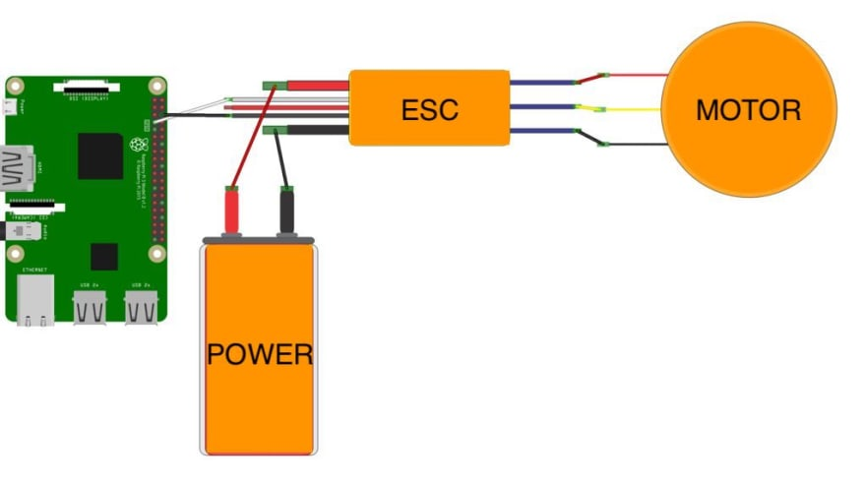
Air Flow Generator
Ducted Fan
Low-cost
Compact
Easy to control
Control the flow by controlling the speed of a ducted fan

Slide 16
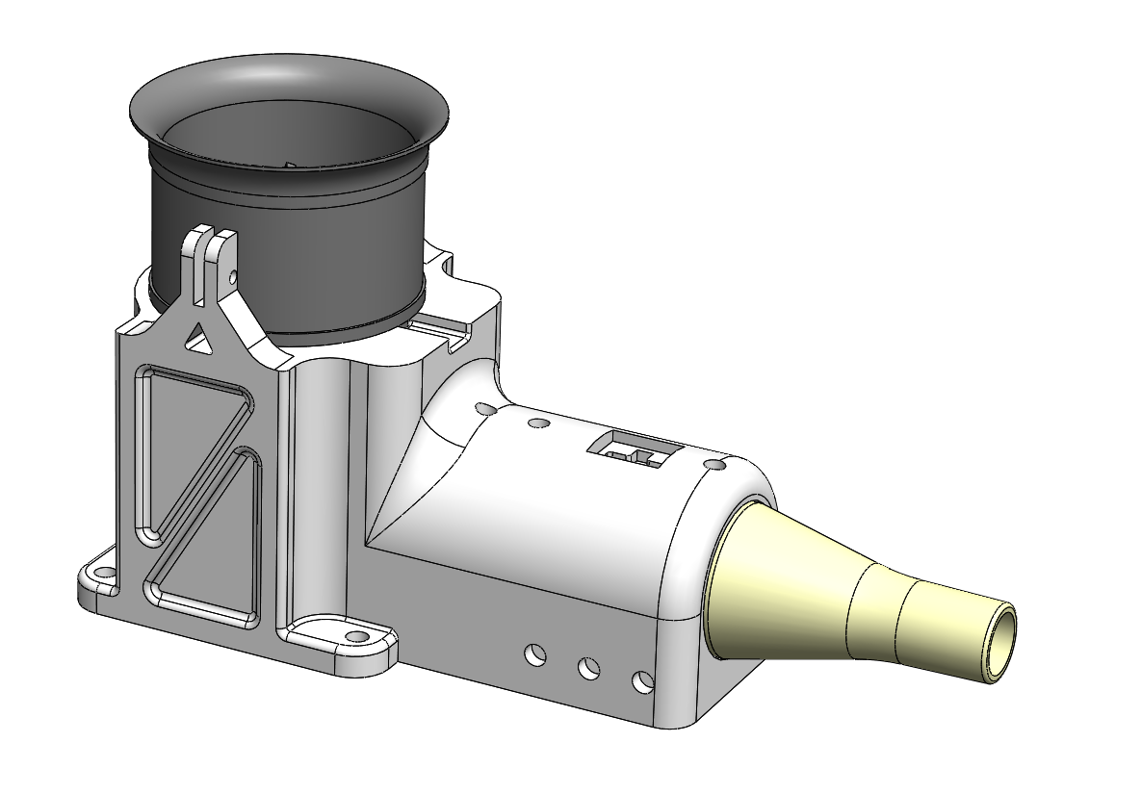
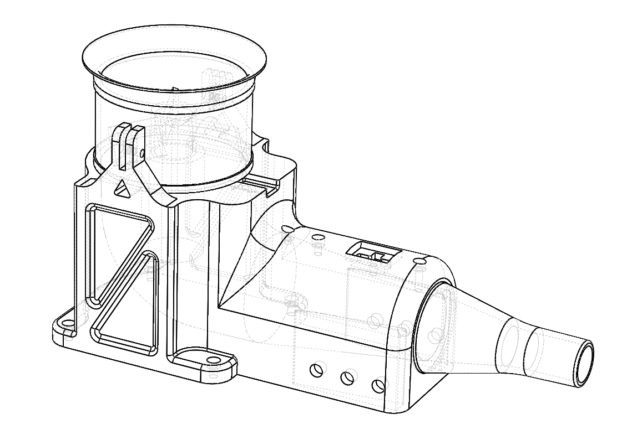
Prototype V1

Slide 17
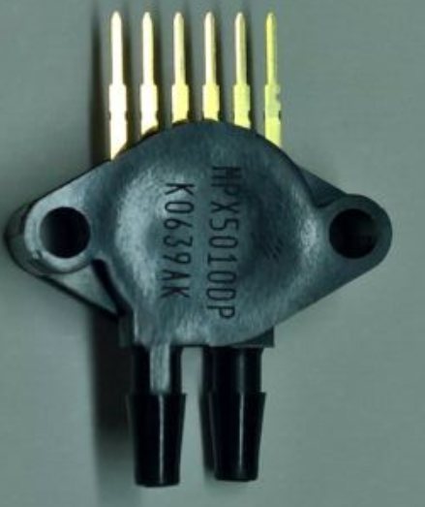
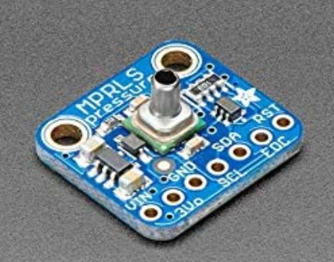

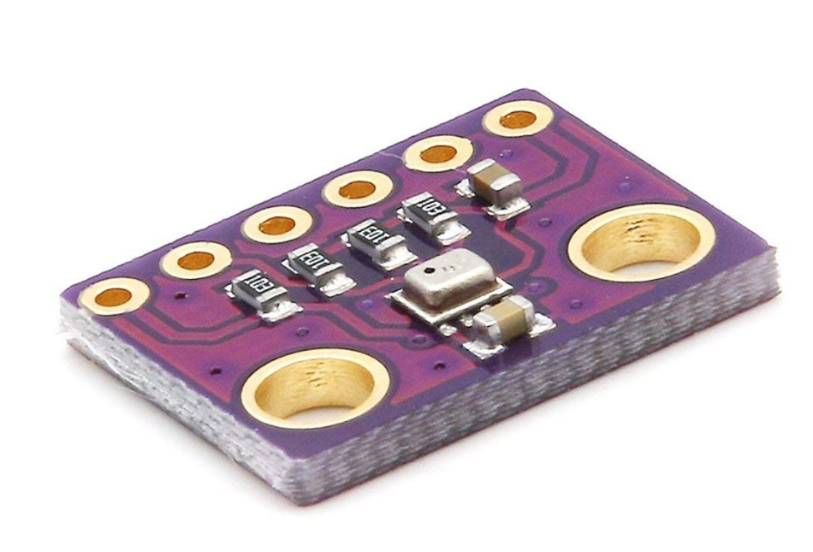


Prototype V1

Slide 18
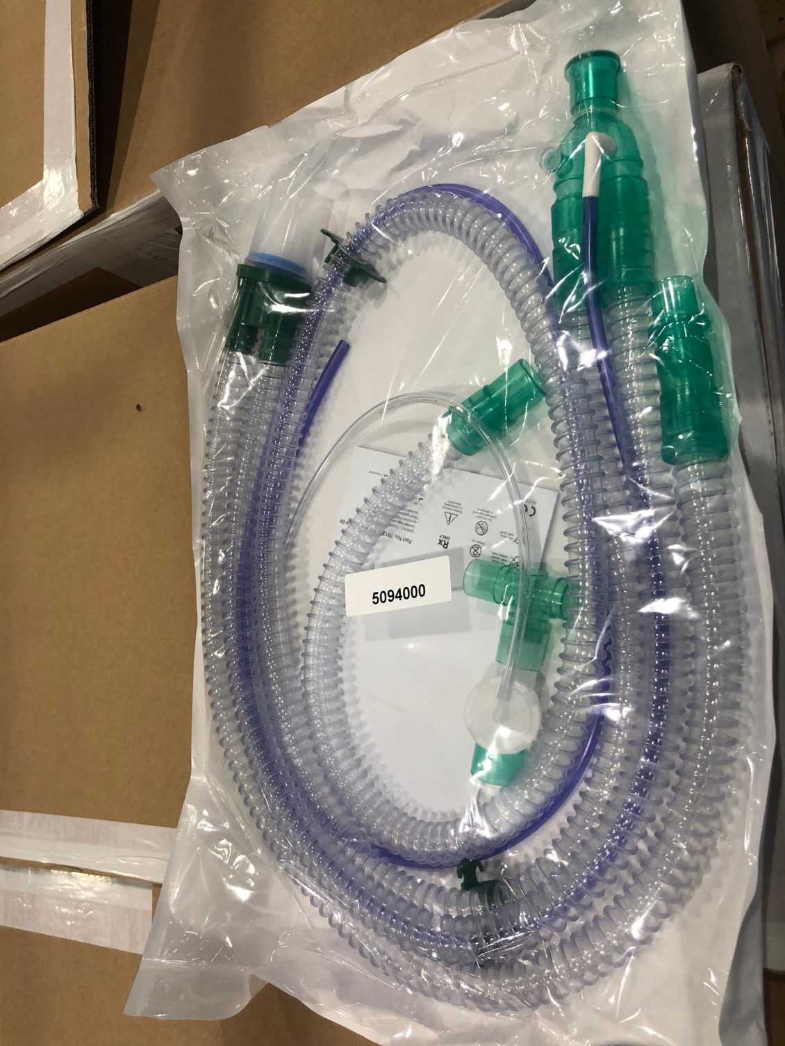
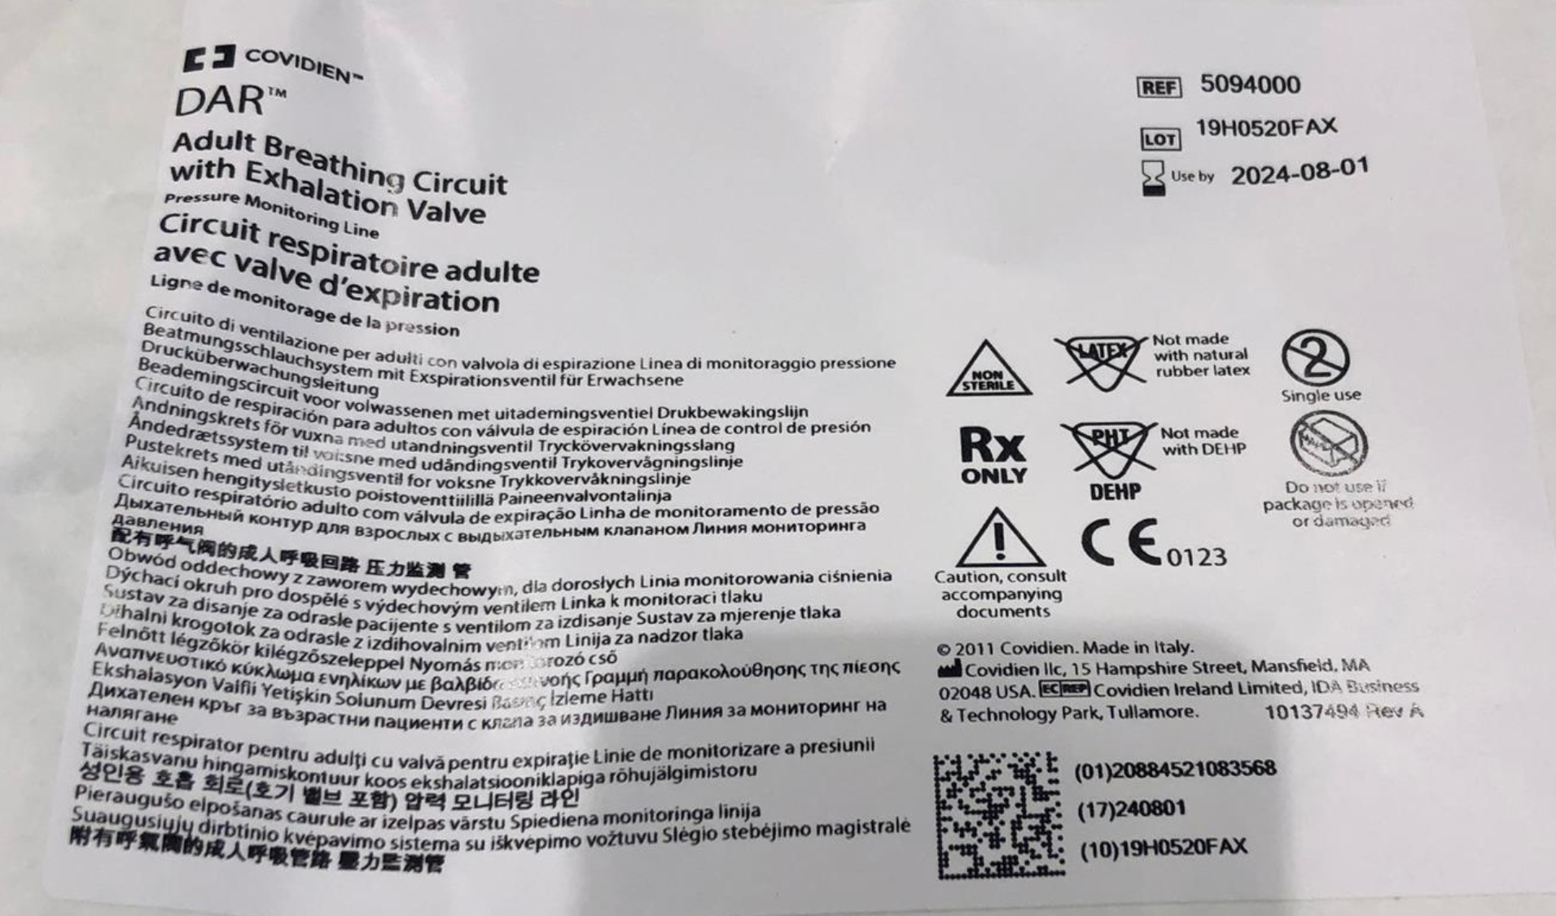

Slide 19
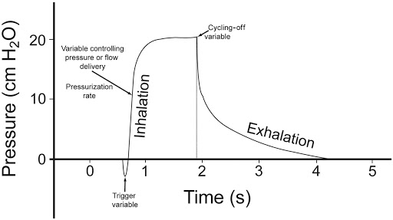
Test

Slide 20
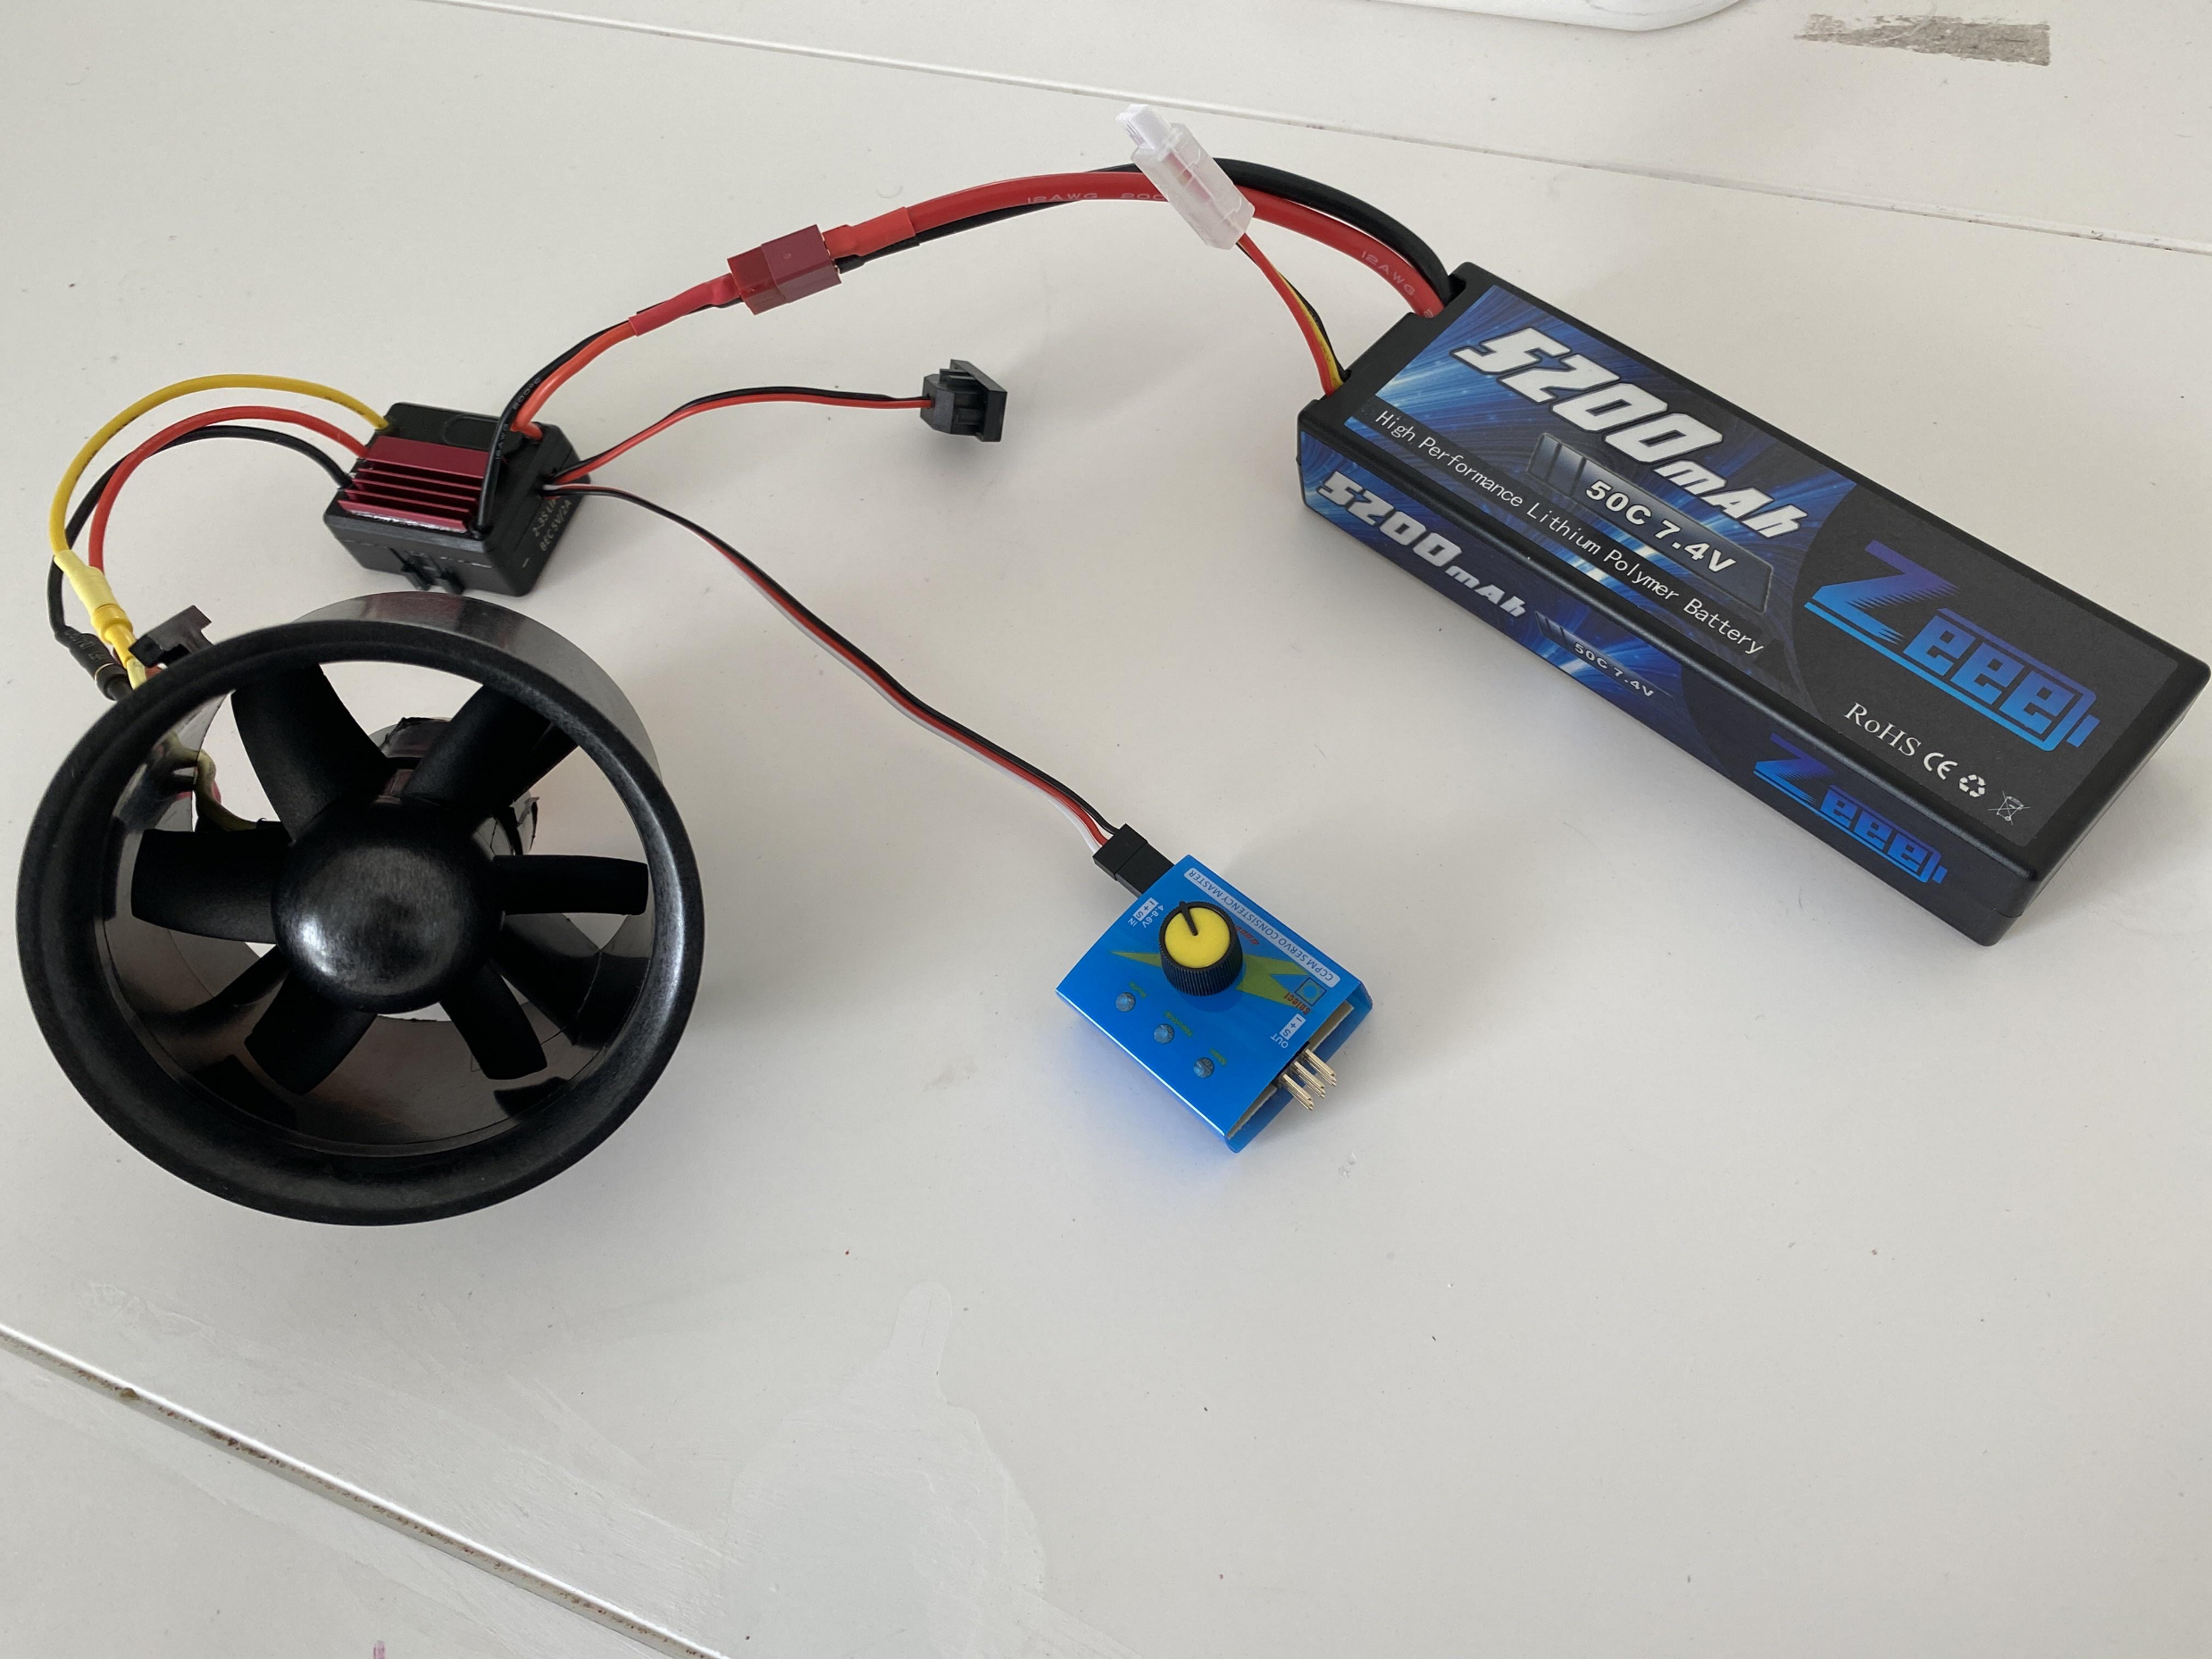
Test

Slide 21
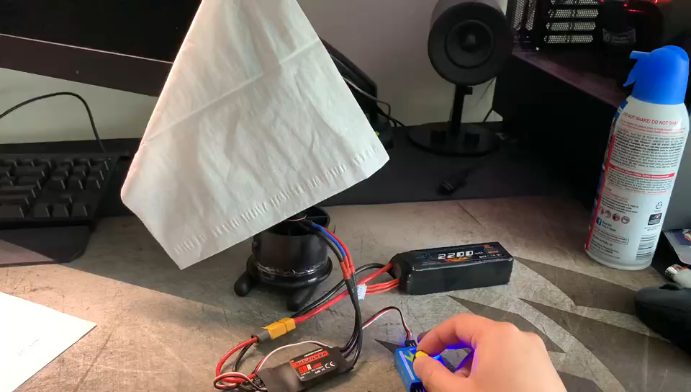
Test

Slide 22
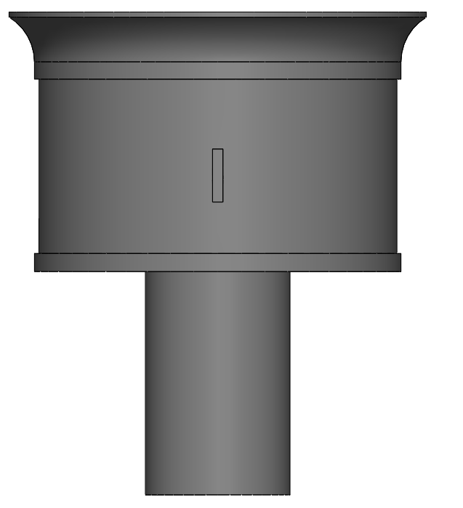
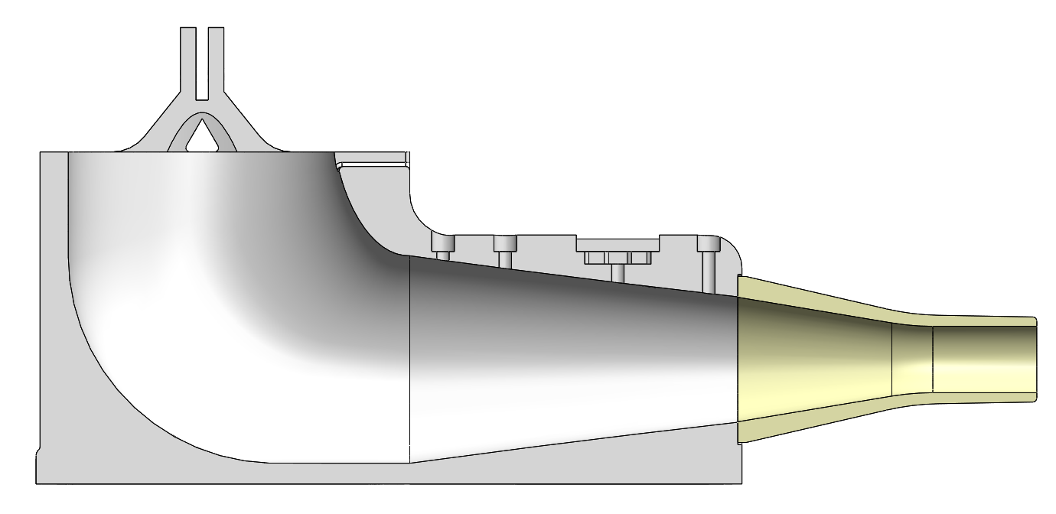
How the Air Flows

Slide 23
Cost
 | unit price | quantity | total | amazon
raspberry pi kit | 99.99 | 1 | 99.99 | link
7'' touch screen | 79.99 | 1 | 79.99 | link
motor tester | 6.79 | 1 | 6.79 | link
motor | 53.27 | 1 | 53.27 | link
solenoid valve | 9.45 | 1 | 9.45 | link
air tube | 13.99 | 1 | 13.99 | link
silicon tube | 6.49 | 1 | 6.49 | link
valve driver | 7.99 | 1 | 7.99 | link
pressure sensor A | 21.99 | 1 | 21.99 | link
pressure sensor B | 9.99 | 1 | 9.99 | link
temperature and humidity sensor | 10.49 | 1 | 10.49 | link
differential pressure sensor | 24.99 | 1 | 24.99 | link
power 12v 30a | 20.99 | 1 | 20.99 | link
air filter | 14.99 | 1 | 14.99 | link
battery | 26.99 | 1 | 26.99 | link
battery charger | 30.99 | 1 | 30.99 | link
ventilator hose | 9.99 | 1 | 9.99 | link
2 part epoxy | 9.49 | 1 | 9.49 | link
balloon | 6.58 | 1 | 6.58 | link
 |  | Total | 465.44

Slide 24
Cost
Raspberry pi | 100
Touch screen 7’’ | 52
Pressure sensor | 20x2
Solenoid Valve - 12V - 1/2" Nominal | 7
Differential pressure sensor | 20
64mm ducted fan + ESC | 53
 | <$400

Slide 25
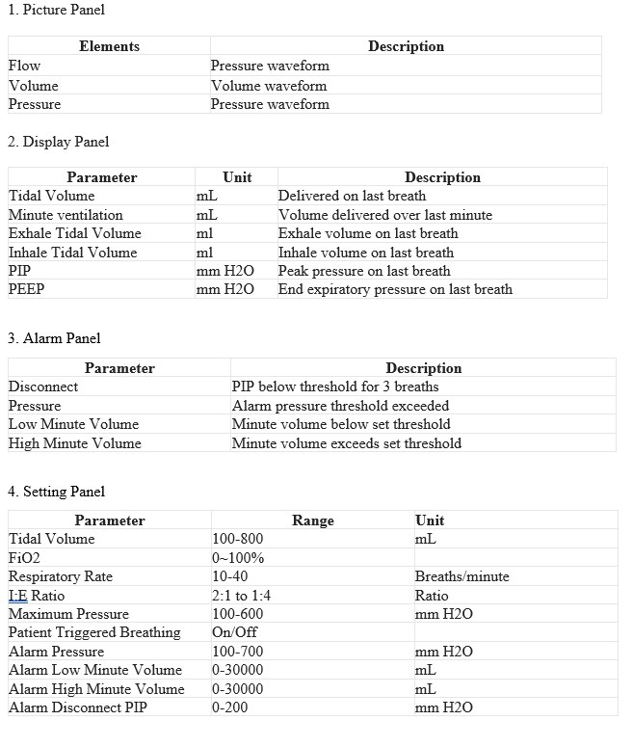

Slide 26
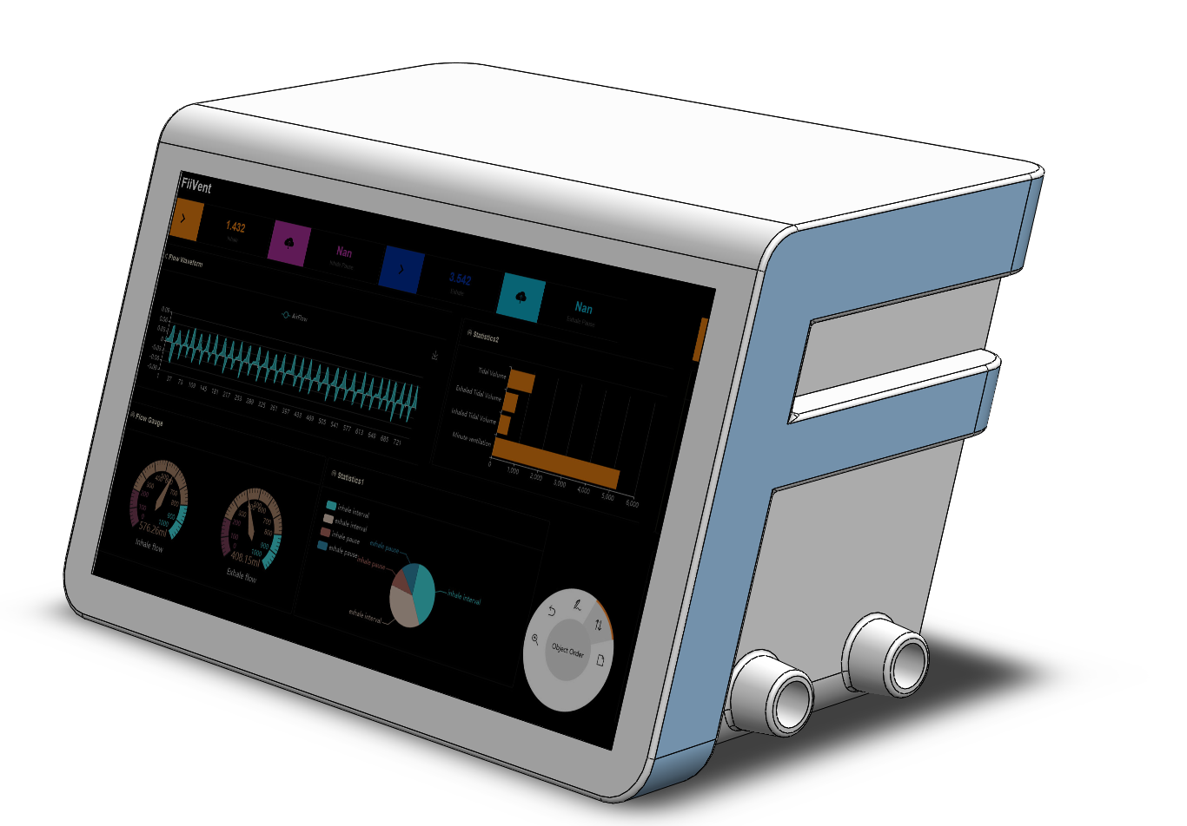

Slide 27
An Open-Source Proportional Valve

Slide 28
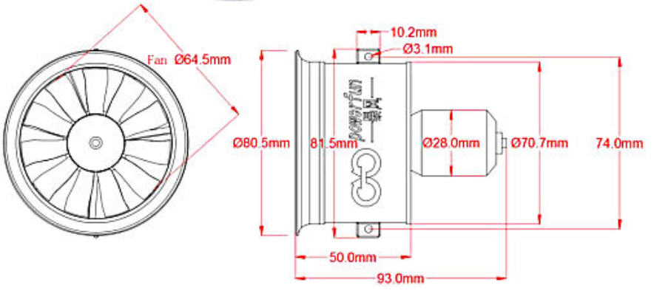
60mm EDF

Slide 30
4Breath

Slide 31
NeoBreath

Slide 32
NeoBreath
Designed by iAI Labs

Slide 33
NeoBreath

Slide 34
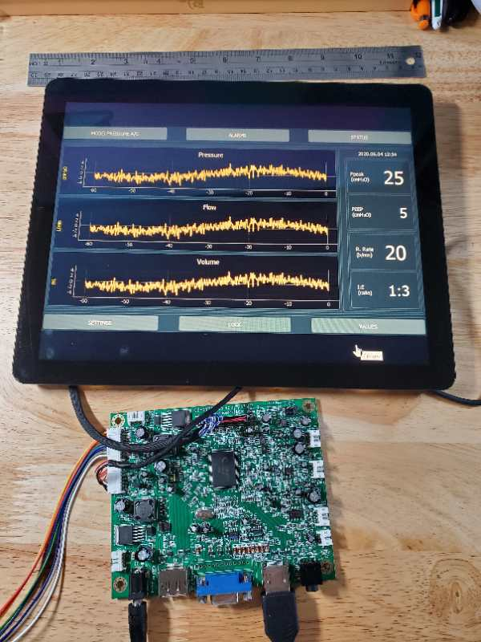

Slide 37


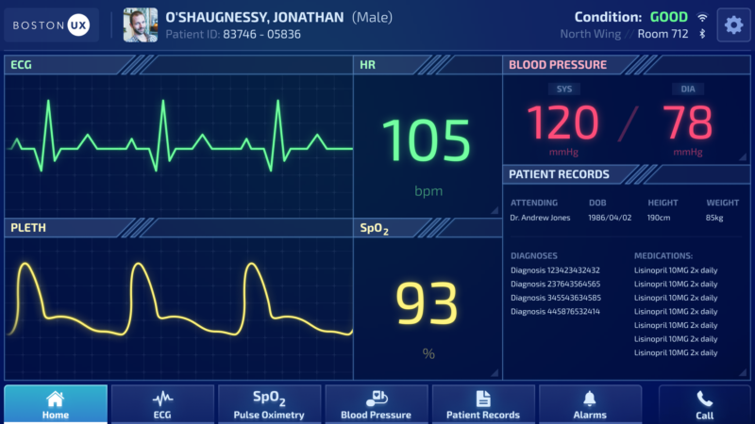
Zacharias Townsend
765-316-1313
9:48 PM
Designed by iAI Labs
Pressure
I:E Ratio
1:3
Flow
Param
225
Volume
Call
Home
Records
Alarms

Slide 38
Designed by iAI Labs
Pressure
I:E Ratio
1:3
Flow
Volume
Call
Home

Slide 39
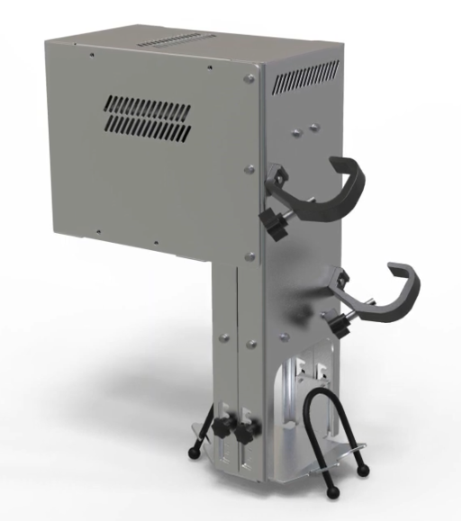

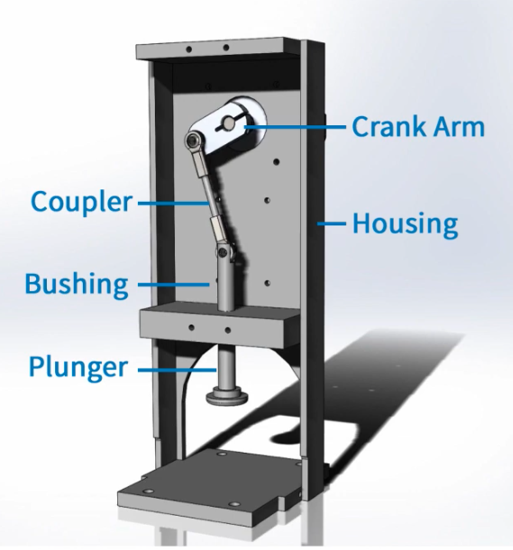
Conventor Automatic Adult Manual Resuscitator Compressor
R&D
Mfg
Stephen Richardson
Aaron Tucker
Arthur Erdman
Needs
Pressure relief (APL) valves
Sheet metal fabrication (laser or water jet)
Supplier/manufacturer of ball joint rod ends
Jim McGurran
Randall Restle
Risks
Supply of Motors
Controls
Medical complications such as: gastric insufflation, volutrauma, barotrauma, etc.
No controls for maintaining pressure, temperature, moisture, %O₂ of the air
Kenny Franek
https://www.teknic.com/open-source-ventilator-prototype-covid-19-patients/ ; https://www.youtube.com/watch?v=Wg2jm-8wD6U&feature=youtu.be
https://med.umn.edu/covid19Ventilator

Slide 40
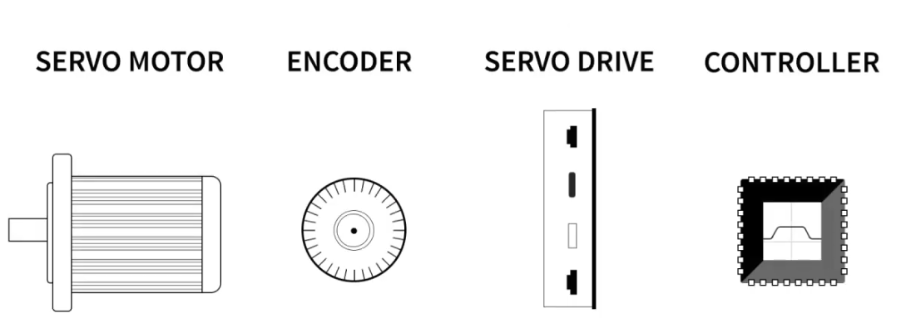
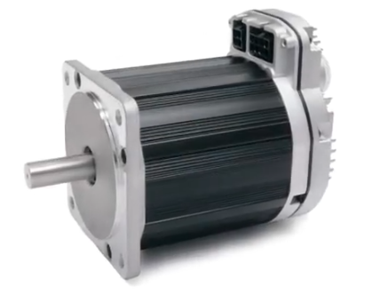
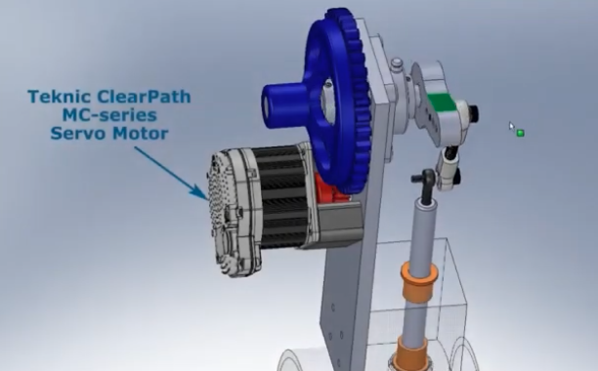
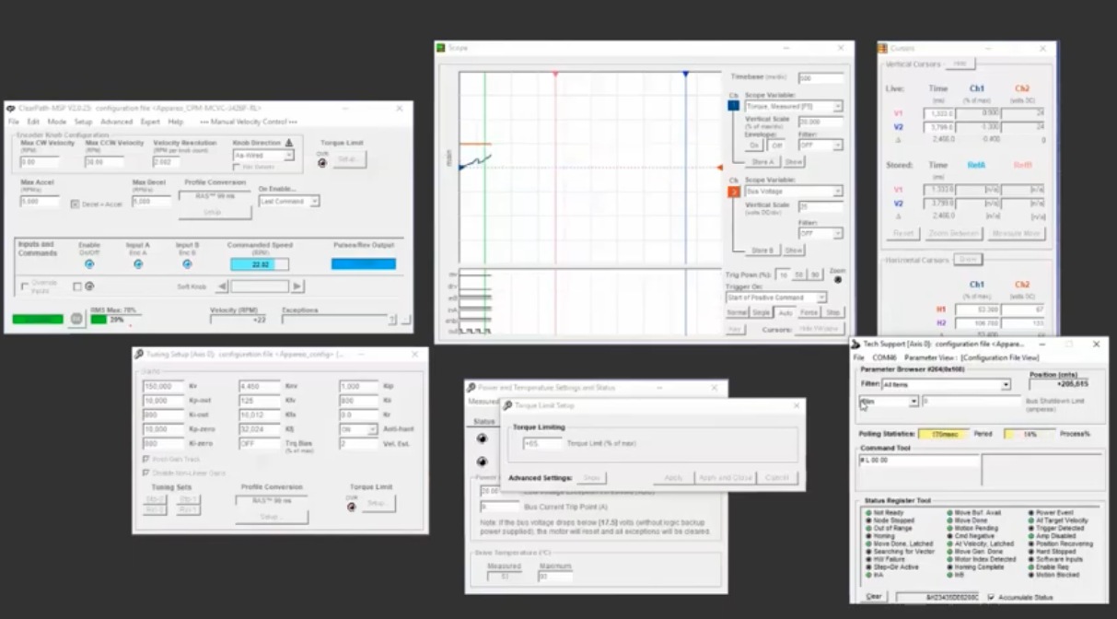
Appendix
Teknic Clearpath:
Torque vs time;
Velocity
Temperature
Position
Bus Voltage
….

Slide 41
Appendix
Existing non-conventional ventilators:
MIT (spirometer included), useful for a do or die situation
UMN
Rice University
Virgin Orbit
AGVA Healthcare (India, smartphone is used as control)
Fit do or die situation, but not suitable for several days’ usage
Patient need to be sedated
Conventional ventilators:
Tightly monitor pressure, temperature, moisture, %O₂ of the air
Breath sequences triggered by patients:
Pressure/ flow/ diaphragm activity, etc
Need fast microprocessors

Slide 43
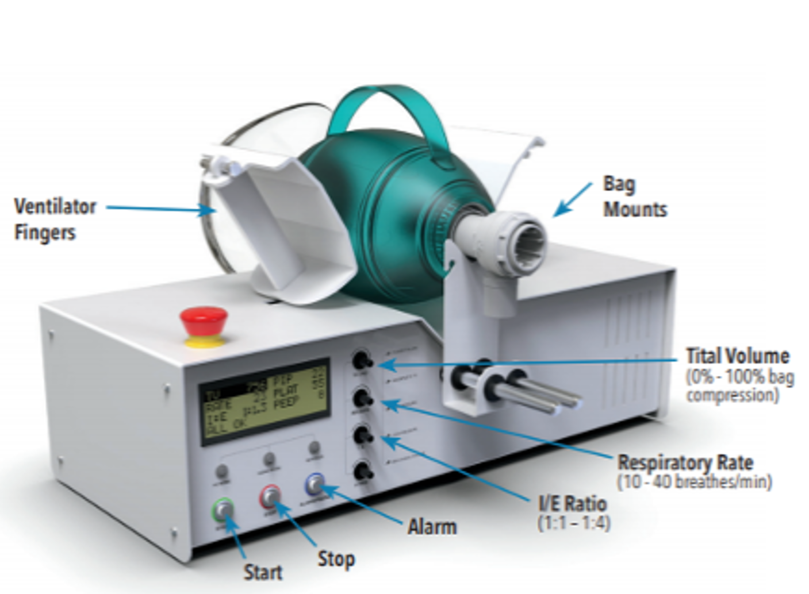
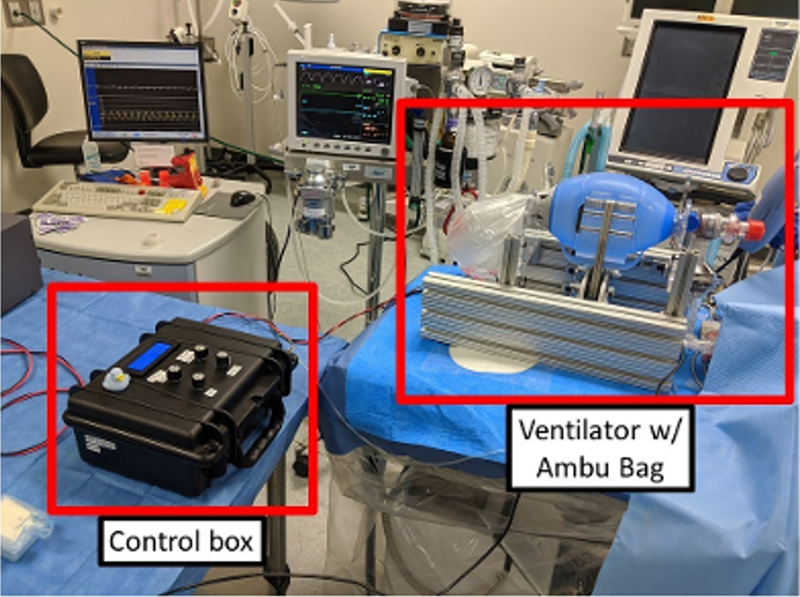
Foxconn MIT E-Vent Project
Version 20200411A
Vecna (Boston)
Debbie Theobald, President
Needs:
Global distribution channel
Software programming support
Connection with demand side
Part sourcing: pressure sensors, DC motors, sheet metals, etc
Drive down Mfg cost 6, Testing, mass producing, etc
Ventiv Product Features 產品特色
EUA application submitted, approving in a few days
Willing to share BOM and Print
Calibrate to multiple brand of manual ventilator bags
Safety alarms for loss of pressure, disconnection, and mechanism malfunction
Track use and events to patient
Easy release of bag for manual ventilation control E. Backup power to provent on-premise power failure
Plans 計劃
Stage 1: Build 100 units with support of local workshops, done in a few weeks
Stage 2: Build 1000 units
Foxconn Stage 1 Help
Help Sourcing digital pressure sensors and alternatives
Help sourcing DC motors
Help sourcing Electronic boards
Provide sheet metals
M.I.T. [Design]
Alex Slocum, M.E.
Daniela Rus, Software
Newlab (NYC) Scott Cohen, CEO
Newlab Product Features 產品特色
Still under development following FDA Emergency Use Resuscitator System Design Guidance
List of alarms and alarm snooze button
An uninterruptible power supply (UPS) with a runtime up to 30 minutes(Under development)
Quickly become familiar without any difficulty
Once stable, can be used by a clinician not skilled in respiratory management
Easy release of bag for manual ventilation control F. Alarm messages update after each breath cycle
Plans 計劃
N/A
Foxconn Stage 1 Help
N/A

Slide 44
EUA application submitted （4/10/2020？）, approval upcoming, date?
Willing to share BOM and Print
Used in conjunction with a manual resuscitator bag
Calibrate to multiple brand of manual ventilator bags
Easy release of bag for manual ventilation control
Visual display of Pressure Measurement (cmH2O)
Loss of pressure, disconnection and mechanism malfunction alarm
No compressed gas tank required
12-V battery power compatible
Track use and events to patient for data
Backup power to prevent power failure
Ventiv (Vecna and MIT) -Automated Manual Resuscitator Compressor
https://vecnahealthcare.com/ventiv/

Slide 45
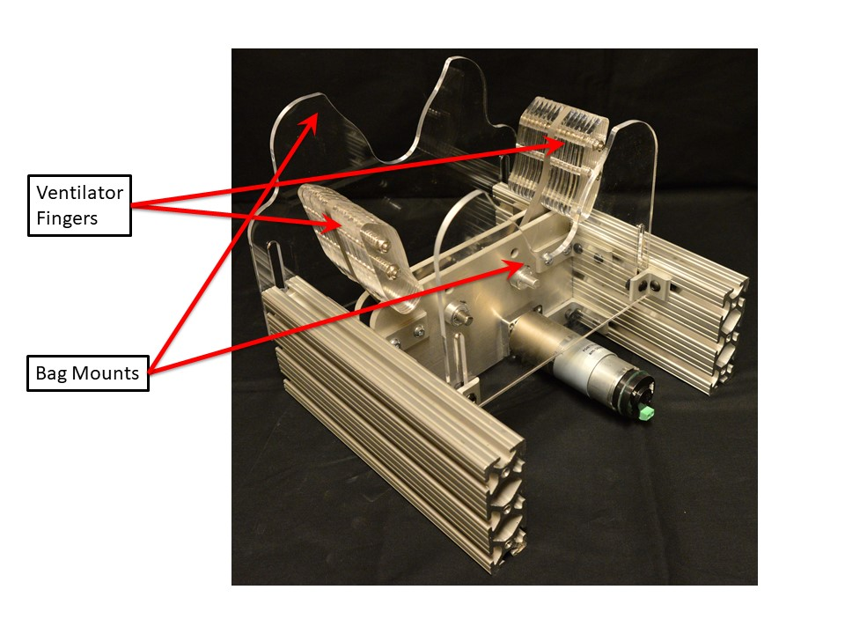
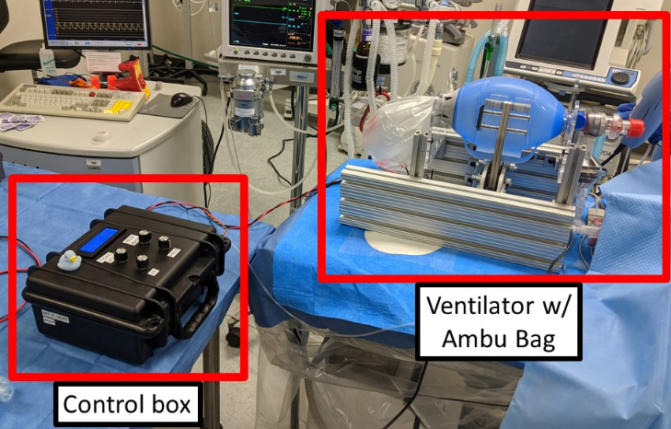


NewLab - MIT Emergency Ventilator
(E-Vent)
Still in the testing procedure and under development following FDA Emergency Use Resuscitator Sys. Design Guid.
Open source, E-vent team releases functionality, design, control strategy and testing result.
Alarm conditions checks for each cycle and has Alarm snooze function
Once stable, can be left in the care of a clinician
12-V battery power compatible
An (UPS) with a runtime up to 30 minutes (Under devel.)
https://e-vent.mit.edu/controls/operation/

Slide 46


BVM (Bag Valve Mask) Resuscitator
Bag valve mask. Part 1 is the flexible mask to seal over the patients face, part 2 has a filter and valve to prevent backflow into the bag (prevents patient deprivation and bag contamination) and part 3 is the soft bag element which is squeezed to expel air to the patient.
Use of the manual resuscitator force-feeds air or oxygen into the lungs in order to inflate them under pressure, thus constituting a means to manually provide positive-pressure ventilation. It is used by professional rescuers in preference to mouth-to-mouth ventilation, either directly or through an adjunct such as a pocket mask.

Slide 47

When using a manual resuscitator, as with other methods of positive-pressure ventilation, the lungs are force-inflated with pressurized air or oxygen. Potential Complications are related to over-inflating or over-pressurizing the patient, which can cause:
air to inflate the stomach (called gastric insufflation);
(2) lung injury from over-stretching (called volutrauma); or
(3) lung injury from over-pressurization (called barotrauma).

